Slide 1

Book Rating Prediction System
Using book metadata and reader review sentiment analysis to power intelligent, accurate rating predictions for digital libraries and online bookstores.
NLP · MACHINE LEARNING · SENTIMENT ANALYSIS

Slide 2
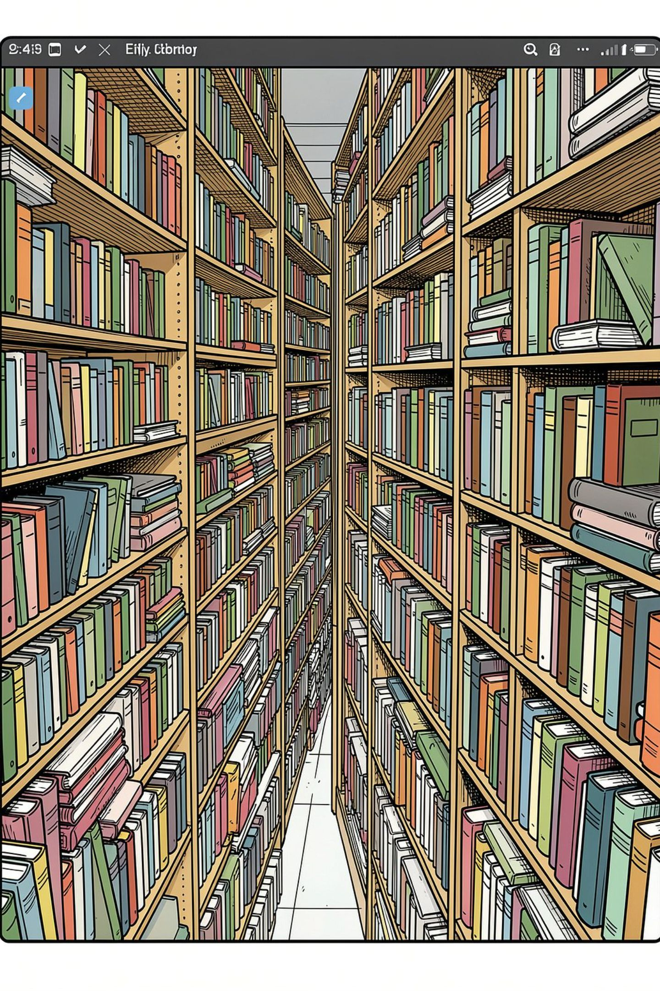
The Problem: Too Many Books, Too Little Signal
Online bookstores and digital libraries host millions of titles, yet readers struggle to identify high-quality books from available information. Traditional rating systems rely solely on user-submitted scores — which are often sparse, inconsistent, or biased. Publishers and platforms lack intelligent tools to estimate book quality before ratings accumulate.

Slide 3

Limitations of Traditional Rating Systems
Sparse Data
Rating Bias
New or niche titles may have few or no ratings, leaving readers without guidance.
Self-selected reviewers skew scores — enthusiastic or disgruntled readers over-represent the average opinion.
No Contextual Intelligence
Static & Non-Predictive
Raw star ratings ignore genre, author reputation, publication quality, and the actual sentiment of written reviews.
Existing systems report historical ratings but cannot predict expected ratings for new or under-reviewed titles.

Slide 4
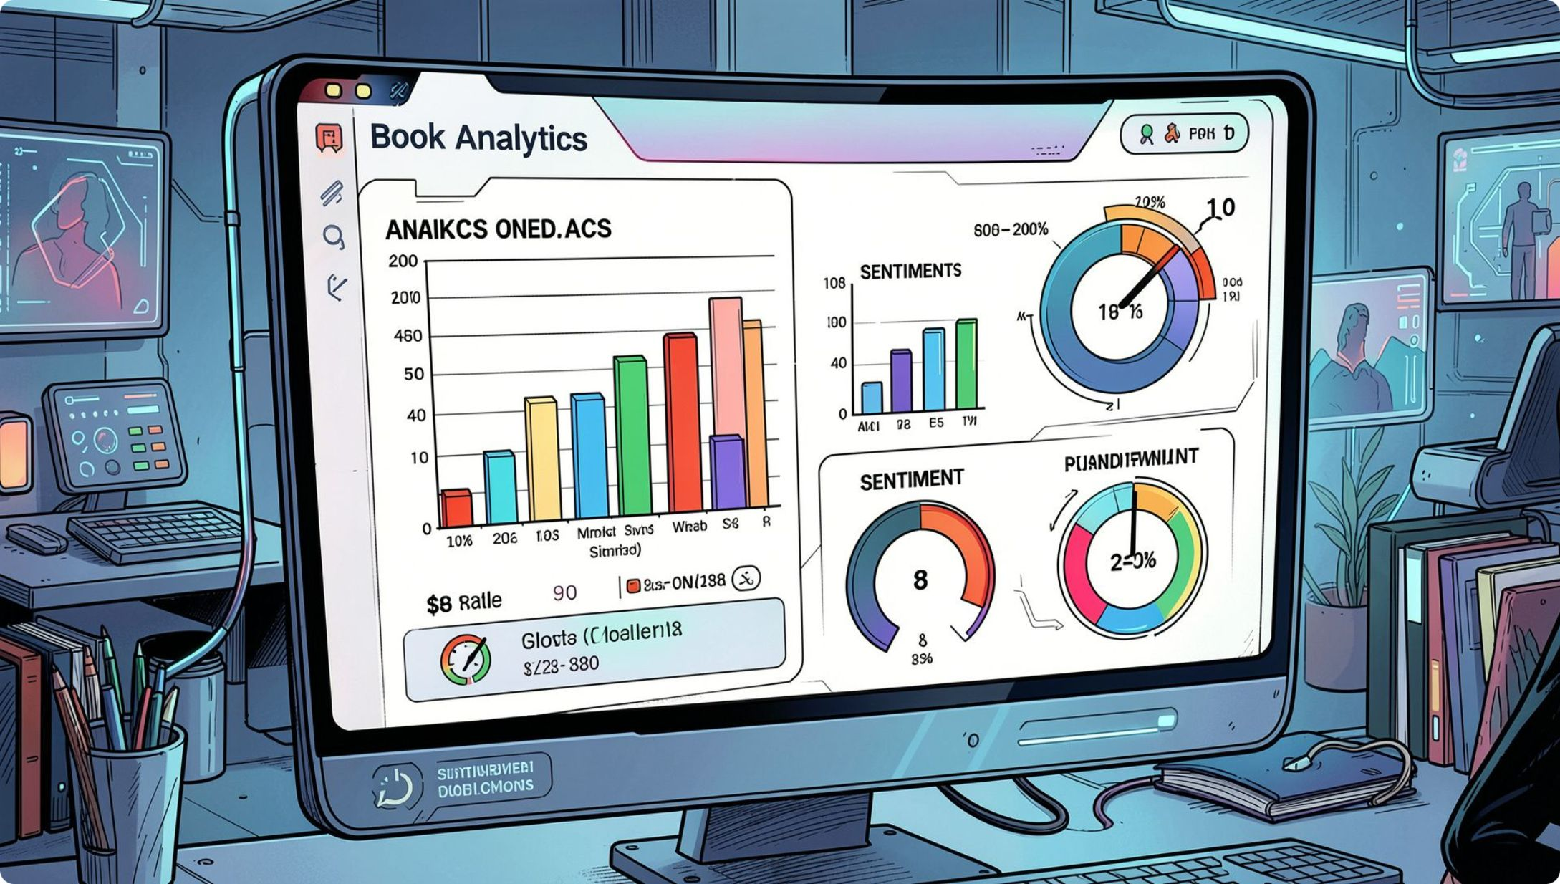
THE SOLUTION
An Intelligent, Unified Prediction Platform
The Book Rating Prediction System integrates book metadata and reader review sentiment through a secure, user-friendly interface. It combines Natural Language Processing, sentiment analysis, and machine learning to estimate expected ratings — generating prediction reports, trend visualisations, and actionable dashboards for readers, publishers, and platforms.

Slide 5
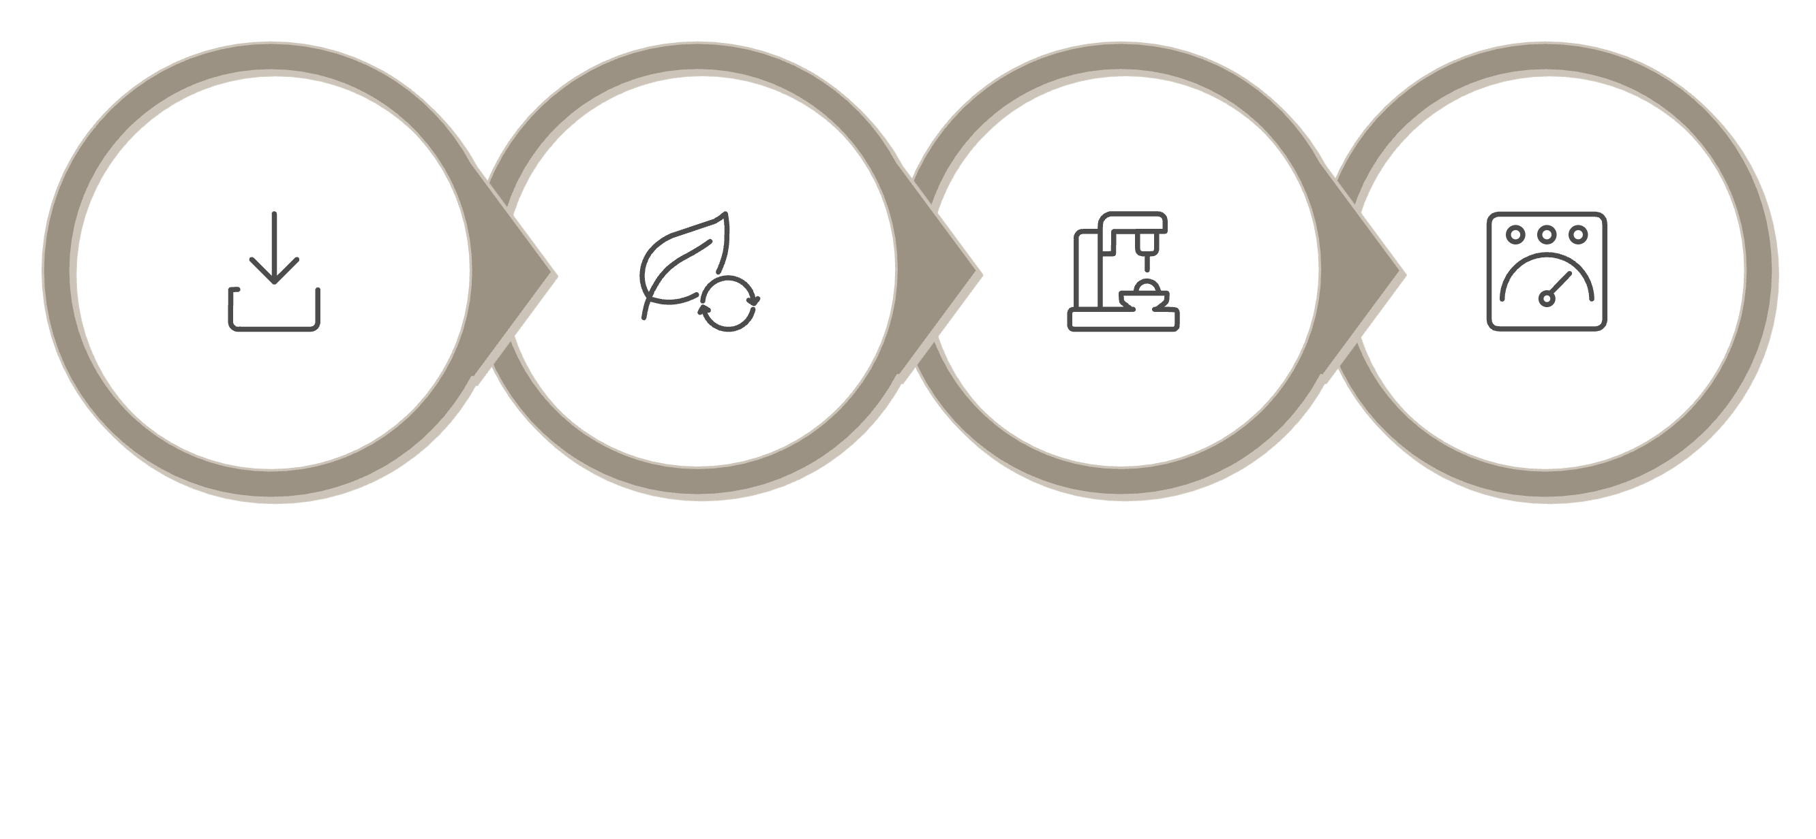
System Architecture at a Glance
NLP & Sentiment
Prediction Model
Reports & Dashboard
Ingestion
The end-to-end pipeline transforms raw book data and unstructured reviews into structured, interpretable rating predictions — delivered through a centralised analytics dashboard.

Slide 6
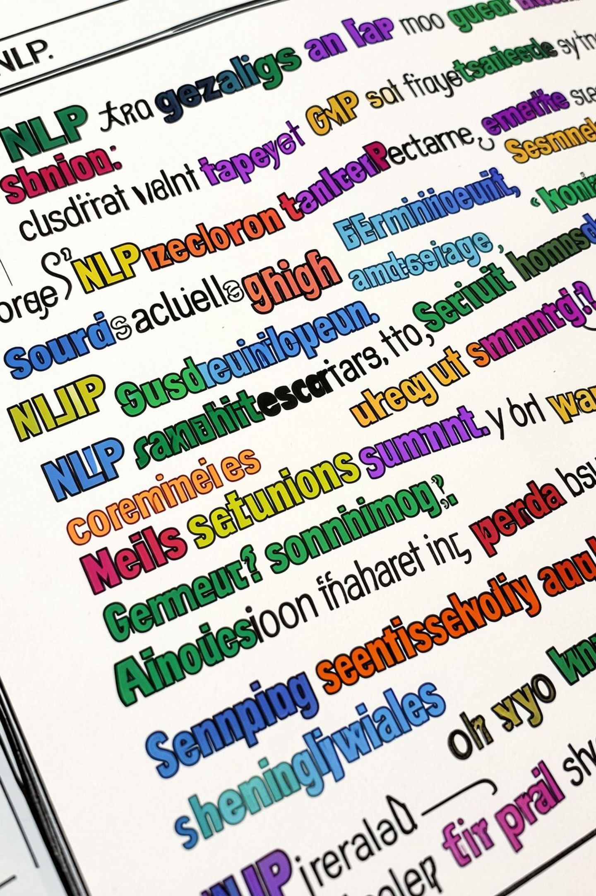
Natural Language Processing & Sentiment Analysis
Review Parsing
Sentiment Scoring
Tokenises and normalises reader reviews, filtering noise and extracting meaningful linguistic features.
Assigns polarity scores (positive, neutral, negative) to review text, capturing reader emotion and opinion intensity.
Feature Engineering
Combines sentiment vectors with metadata features — genre, author, publication year — into a unified model input.

Slide 7
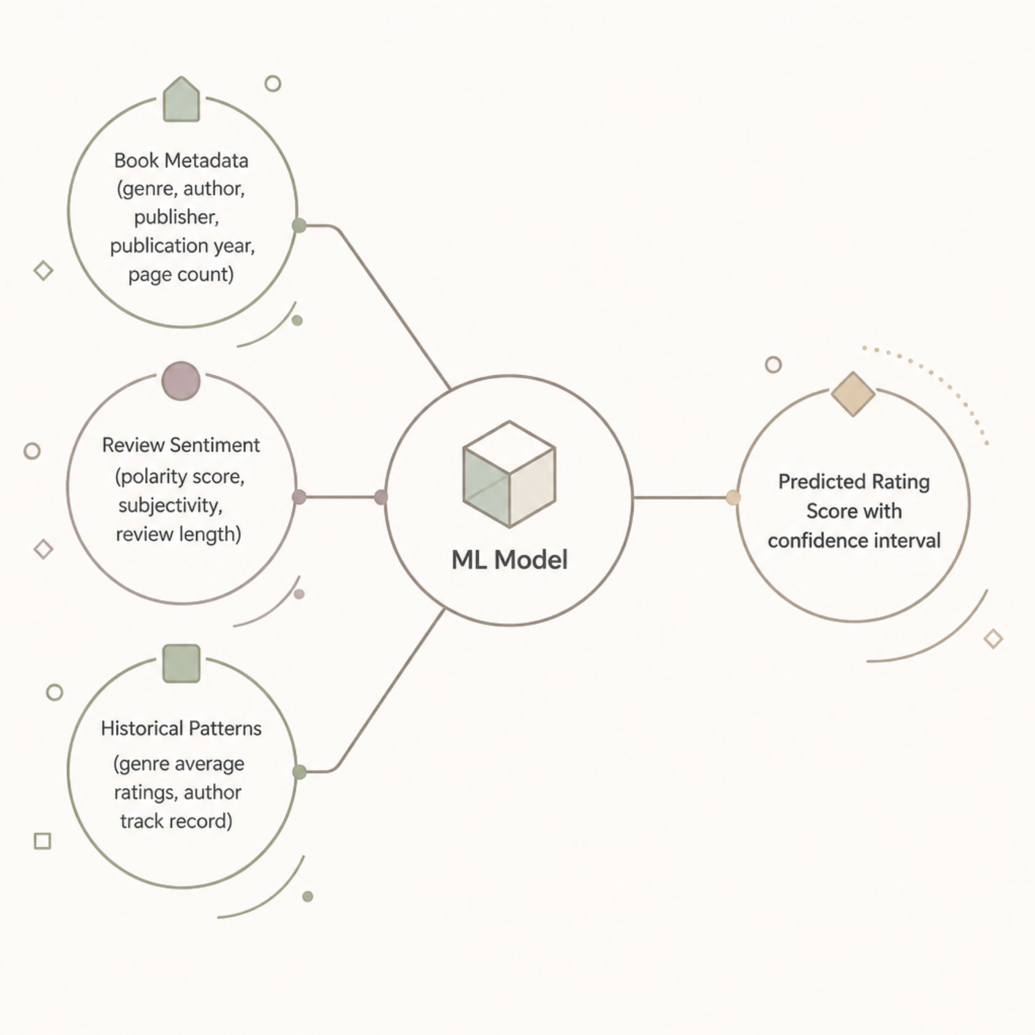

Machine Learning Prediction Model
What the Model Learns
The ML model is trained on historical book-rating pairs, learning how metadata attributes and sentiment signals correlate with actual reader ratings. It generalises to new titles by recognising patterns across genre norms, author reputation, and the emotional tone of early reviews.
Predictions include a confidence interval, enabling platforms to weigh certainty when surfacing recommendations.

Slide 8
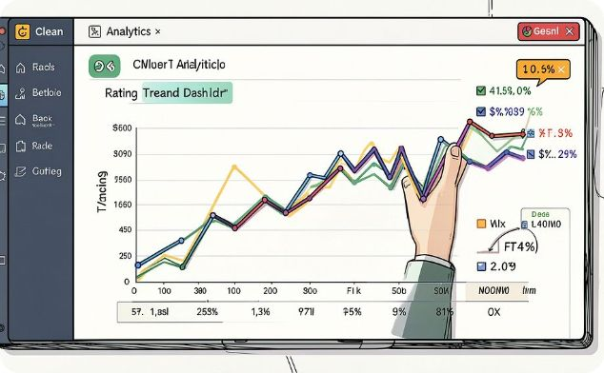
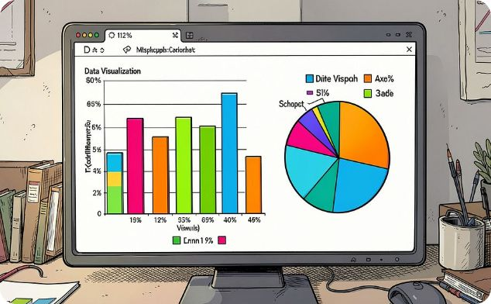
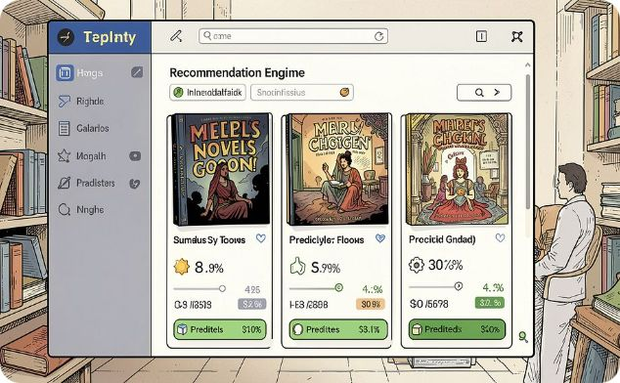
Dashboard & Visualisation Outputs
Rating Trend Reports
Genre & Author Analytics
Recommendation Integration
Visualise predicted vs. actual ratings over time, identifying shifts in reader sentiment and genre performance.
Break down predictions by genre, author, and publisher to uncover quality patterns across the catalogue.
Predicted scores feed directly into recommendation engines, improving discovery for under-reviewed titles.

Slide 9





Who Benefits & How
Readers
Discover high-quality titles earlier, even before ratings accumulate — reducing decision fatigue.
Publishers
Gauge anticipated reader reception and refine marketing strategies based on predicted sentiment trends.
Online Bookstores
Improve recommendation accuracy, reduce cold-start problems, and increase user engagement and conversions.
Digital Libraries
Curate collections intelligently, prioritise acquisitions, and optimise content management workflows.

Slide 10

Key Takeaways
1
Beyond Star Ratings
2
NLP-Powered Intelligence
Predicts book quality using metadata and sentiment — not just historical user scores.
Sentiment analysis decodes the emotional signal in reviews, adding depth to raw ratings.
3
Actionable, Scalable Outputs
4
Secure & Production-Ready
Delivers dashboards, trend reports, and confidence-scored predictions for real-world platforms.
Designed for digital libraries, bookstores, publishers, and recommendation engines at scale.
This system represents a modern, intelligent analytics layer — transforming how book quality is measured, predicted, and surfaced across the digital reading ecosystem.

